Slide 1
HW9 Framework

Slide 2
Step 1
Packages needed
library("kernlab")
library(e1071)
library(ggplot2)
library(gridExtra)
library(caret)
Acquire, transform data
airquality
Transform NA’s in solar & ozone with mean

Slide 3
Step 2
Create train & test data sets via examples in chapter 18

Slide 4
Step 3
Build model with train data , use ksvm function
Test model with test data set (predict) & calc RMSE
Plot result
To help you calc RMSE & plot, see sample code next slide
Note: code below is after you run ksvm and predict

Slide 5
# create a comparison dataframe that contains the exact "Ozone" value and the predicted "Ozone" value
compTable <- data.frame(testData[,1], svmPred[,1])
# change the column names to "test" and "Pred"
colnames(compTable) <- c("test","Pred")
# compute the Root Mean Squared Error
sqrt(mean((compTable$test-compTable$Pred)^2))
# 3) Plot the results
library(ggplot2)
# compute absolute error for each case
compTable$error <- abs(compTable$test - compTable$Pred)
# create a new dataframe contains error, temperture and wind
svmPlot <- data.frame(compTable$error, testData$Temp, testData$Wind)
# assign column names
colnames(svmPlot) <- c("error","Temp","Wind")
# plot result using ggplot, setting "Temp" as x-axis and "Wind" as y-axis
ggplot(svmPlot, aes(x=Temp,y=Wind)) +
# use point size and color shade to illustrate how big is the error
geom_point(aes(size=error, color=error))+
ggtitle("ksvm")

Slide 6
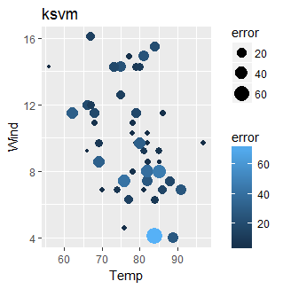

Slide 7
Step 3 – 4)
Use train & test data sets with
svm function
calc RMSE
Plot
lm function
calc RMSE
Plot

Slide 8
Step 3 – 5)
Plot all 3 via gridExta function
Up to this point you should have:
3 RMSE values
4 plots

Slide 9
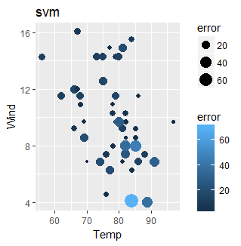

Slide 10
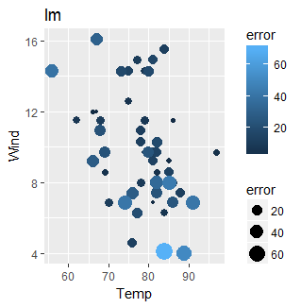

Slide 11
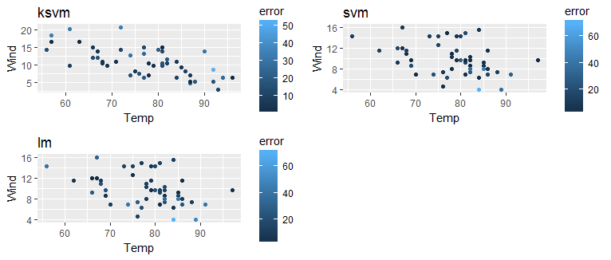

Slide 12
Pause
Previous models were linear/algebra in nature
Predicting specific values
Next models will be “classification” oriented ie.
good ozone, bad ozone
spam, not spam
promoter, passive, detractor (hint)

Slide 13
Step 4
Create a “goodOzone” variable, add to your existing test & train dataframes
Method
Calc mean ozone
Compare individual ozone values to the mean
If individual ozone value is less than mean assign 0 to goodOzone
If individual value is equal to or greater than the mean assign 1 to goodOzone
When complete remove ozone variable from test and train dataframes
Make sure goodOzone is factor

Slide 14
Step 5
Build model with train data , use ksvm function
Test model (predict) with test data set , compute % of goodOzone correctly predicted
Note: we are using the df’s that contain the goodOzone variable
Plot result
To help you calc % good & plot, see sample code next slide
Note” code below is after you run ksvm with goodOzone variable and predict with goodOzone variable

Slide 15
# create a dataframe that contains the exact "goodOzone" value and the predicted "goodOzone"
compGood1 <- data.frame(testData[,6], goodPred)
# change column names
colnames(compGood1) <- c("test","Pred")
# Compute the percentage of correct cases
perc_ksvm <- length(which(compGood1$test==compGood1$Pred))/dim(compGood1)[1]
perc_ksvm
# 3) Plot the results.
# determine the prediction is "correct" or "wrong" for each case
compGood1$correct <- ifelse(compGood1$test==compGood1$Pred,"correct","wrong")
# create a new dataframe contains correct, tempreture and wind, and goodZone
Plot_ksvm <- data.frame(compGood1$correct,testData$Temp,testData$Wind,testData$goodOzone,compGood1$Pred)
# change column names
colnames(Plot_ksvm) <- c("correct","Temp","Wind","goodOzone","Predict")
# plot result using ggplot
# size representing correct/wrong; color representing actual good/bad day; shape representing predicted good/bad day.
ggplot(Plot_ksvm, aes(x=Temp,y=Wind)) +
geom_point(aes(size=correct,color=goodOzone,shape = Predict))+
ggtitle("ksvm - good/bad ozone")

Slide 16
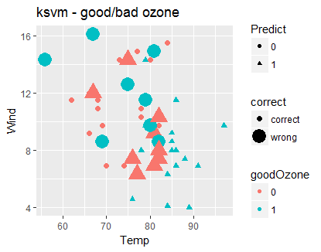

Slide 17
Step 5 – 4)
Use train & test data sets with
svm function
calc % goodOzone
Plot
Naïve Bayes function
calc %goodOzone
Plot
Plot all 3 via gridExta function
Up to this point you should have:
3 % goodOzone values
4 plots

Slide 18
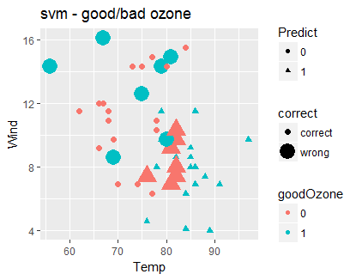

Slide 19
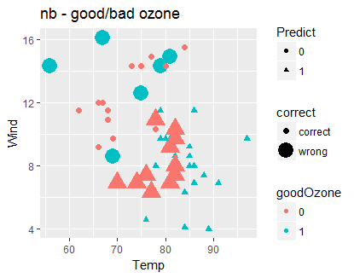

Slide 20
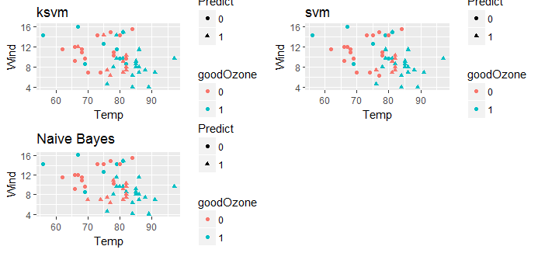

Slide 21
Step 6
Which are the best models for this data and why
Using ‘real ozone’ value
Using “goodOzone” value

Slide 22
Appendix

Slide 23
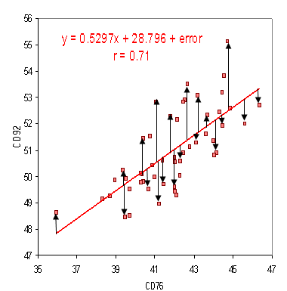
What is Root Mean Square Error (RMSE)?
Root Mean Square Error (RMSE) is the standard deviation of the residuals (prediction errors). Residuals are a measure of how far from the regression line data points are; RMSE is a measure of how spread out these residuals are. In other words, it tells you how concentrated the data is around the line of best fit. Root mean square error is commonly used in climatology, forecasting, and regression analysis to verify experimental results.

Slide 24
Support Vector Machines for dummies; A Simple Explanation
http://blog.aylien.com/support-vector-machines-for-dummies-a-simple/

